Slide 1


Story time!
Robert Axelrod
Notes:
90% of this talk is based on work by Robert Axelrod, a professor of political science and public policy at University of Michigan, Ann Arbor. The first paper on this topic was published in 1980. Axelrod has done research in other areas of political science, but this is the work by which he is best known. He remains active today in related research.

Slide 2

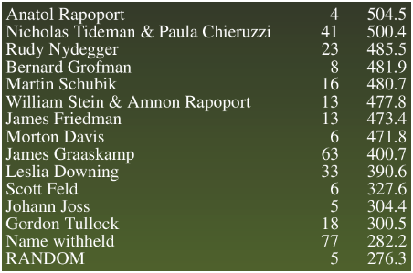
Contest #1
C
D
Call for entries to game theorists
All entrants told of preliminary experiments
15 strategies =
14 entries + 1 RANDOM
Round-robin tournament against all other players and “twin”
Each game: 200 iterations
C
3 3
0 5
D
5 0
1 1

Slide 3
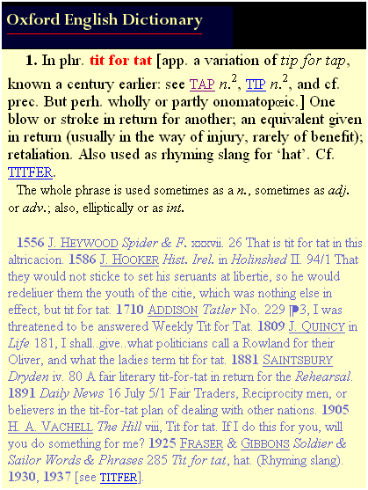
And, the winner is…
TIT FOR TAT
“Cooperate on first move, thereafter reciprocate opponent’s previous action”
Shortest program submitted
By psychologist, Anatol Rapoport

Slide 4
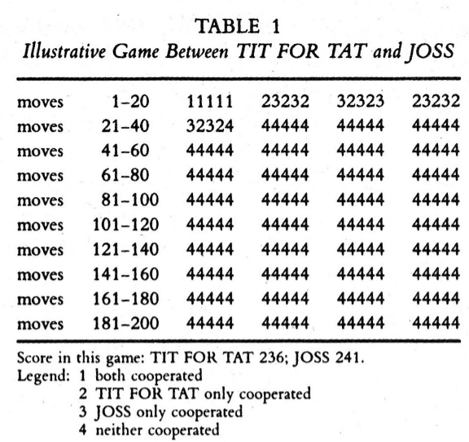
What’s wrong with TIT FOR TAT?
Not subgame
perfect!
One-period Nash reversion, however, is subgame perfect.

Slide 5
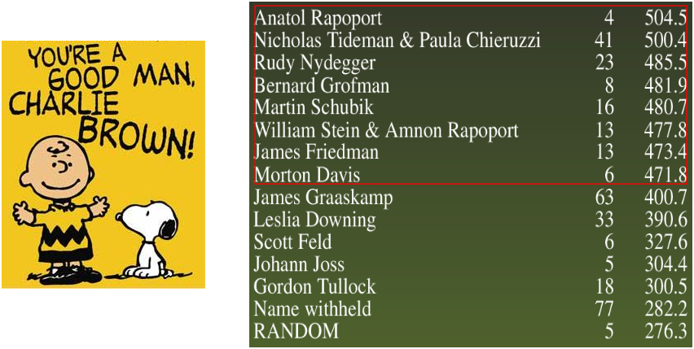
Analysis: “Nice” Guys Finish First
Top 8 strategies never defect first.
Notes:
“Nice” defined to mean not being the one to defect first.
The gap in scores between top 8 and the remainder is the largest gap in the table.
Nice strategies do well with each other, because they never defect, so they get 600 points each against one another.

Slide 6
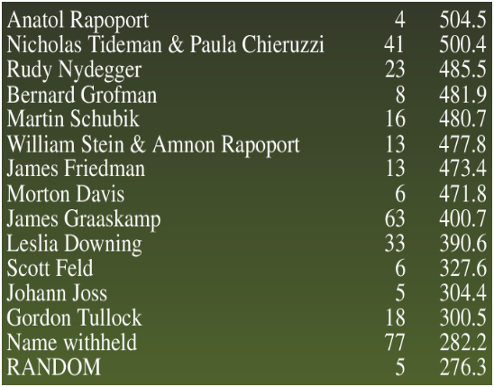

Analysis: To Forgive, Divine
Top two rules are willing to cooperate even after defections, if other player is “contrite”
DOWNING
- “Kingmaker”
- Tries to learn behavior of other player; starts by defecting twice.
- Hurts strategies that are unforgiving.
Notes:
“Nice” defined to mean not being the one to defect first.
The gap in scores between top 8 and the remainder is the largest gap in the table.
Nice strategies do well with each other, because they never defect, so they get 600 points each against one another.

Slide 7
Other Interesting Strategies
TIT FOR TWO TATS
Retaliate only if previous two are D’s
Would have won tournament, if entered
NICE DOWNING
Like DOWNING, but start with C’s
Would have won tournament, if entered

Slide 8
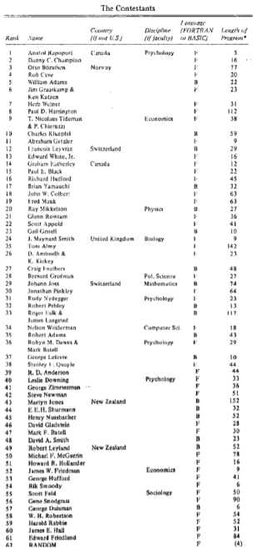
Contest #2
Same set up as Contest #1, except…
Entries from first-round contestants as well as open call in magazine
63 strategies =
62 entries + 1 RANDOM
Each game iterated an uncertain number of times, with probability 0.00346 of ending

Slide 9
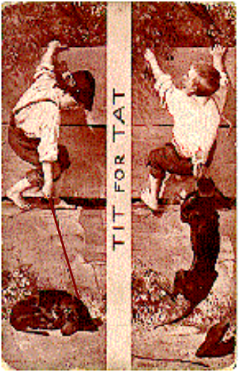
And, the winner is…
TIT FOR TAT, again!
(Again, by Anatol Rapoport)

Slide 10
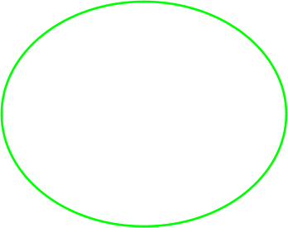
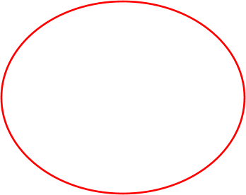
Analysis: Contest #1 Lessons Validated
14 of top 15 strategies never defect first.
14 of bottom 15 strategies were not “nice”.
Forgiveness important.
Notes:
“Nice” defined to mean not being the one to defect first.
The gap in scores between top 8 and the remainder is the largest gap in the table.
Nice strategies do well with each other, because they never defect, so they get 600 points each against one another.

Slide 11
Analysis: Be Retaliatory
Some entrees tried to take advantage of “nice” strategies:
TRANQUILIZER – cooperate first, if other cooperates, too, throw in a few defections.
TESTER – defect first, if other doesn’t retaliate, cooperate twice, then alternate defection and cooperation. If other ever defects, do TIT FOR TAT.
TIT FOR TWO TATS and NICE DOWNING were both submitted in contest #2, and both got clobbered by TRANQUILIZER and TESTER.
Notes:
“Nice” defined to mean not being the one to defect first.
The gap in scores between top 8 and the remainder is the largest gap in the table.
Nice strategies do well with each other, because they never defect, so they get 600 points each against one another.

Slide 12

Analysis: Sneaki-ness Doesn’t Pay
Entrees that try to take advantage of “nice” strategies don’t gain as much as they lose.
TRANQUILIZER – 27th place in tournament.
TESTER – 46th place in tournament (out of 63).
Notes:
“Nice” defined to mean not being the one to defect first.
The gap in scores between top 8 and the remainder is the largest gap in the table.
Nice strategies do well with each other, because they never defect, so they get 600 points each against one another.

Slide 13
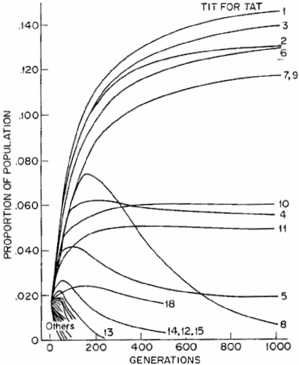
Robustness of TIT FOR TAT
In six variations of Contest #2, TIT FOR TAT took first place in five and second place in one.
In a population simulation with 63 strategies (right), TIT FOR TAT emerges as the winner.
In an genetic algorithm experiment (1987), TIT-FOR-TAT-like algorithms prevailed.
Notes:
What’s interesting about the graph is that…
-- Some strategies die off immediately. These are usually strategies that are not “nice” or those which are too cooperative.
-- Some strategies do well and continue to do so. These are TIT FOR TAT-like.
-- Some strategies do well for a while and then fall off. These are strategies that try to take advantage of others. They do well for a while, but then die off when the population becomes more dominated by TIT FOR TAT strategies.

Slide 14
General Lessons
Don’t be envious. (It doesn’t matter if others win.)
TIT FOR TAT never scores more than the other player.
Be nice. (Don’t defect first.)
The best way to do well is to cooperate with others who are also nice.
Retaliate swiftly.
Or else others will take advantage.
Forgive.
Feuds are costly. Defections shouldn’t prevent cooperation later on.
Don’t be too clever.
Too much cleverness looks RANDOM.
Notes:
These apply only if you’re playing a non-zero-sum game that has structure that is similar to the iterated Prisoner’s Dilemma.
A slightly modified version of Axelrod’s advice.

Slide 15

Trench Warfare as repeated PD
You
Payoff Matrix
Cooperate
Shoot to Kill
Cooperate
You live and hurt other side.
Both live.
Them
Shoot to Kill
You die and they win.
Both die.
For a single round, no matter what the enemy does, it’s better to shoot to kill.
But for an indefinite number of rounds…?
Notes:
Two criminals are taken as suspects by police, with very strong evidence that one or both of the suspects committed the crime. They are interrogated separately. Each has the option to tell the truth and confess to the crime (cooperate) or to lie and claim the other person did it (defect). If they both tell the truth (cooperate), the judge goes easy on them for being repentant, and they get only two years in jail. If they both lie (defect), the judge finds them unrepetant and sends them both to four years in jail. If one lies (defects) and the other confesses (cooperates), then the defector gets no years in jail, since both suspects agreed the defector didn’t do it, and the cooperator gets five years in jail, since he is considered to have perpetrated the whole crime.

Slide 16
Trench Warfare in WWI
Cooperation spontaneously evolved:
“If the British shelled the Germans, the Germans replied, and the damage was equal.”
“[A British staff officer was] astonished to observe German soldiers walking about within rifle range…”
“These people … did not know there was a war on. Both sides … believed in … ‘live and let live’.”
“Suddenly a salvo arrived but did no damage. Naturally both sides got down and our men started swearing at the Germans, when all at once a brave German got on to his parapet and shouted out ‘We are very sorry about that; we hope no one was hurt. It is not our fault, it is that damned Prussian artillery.’”
Notes:
This is notable, because it happened between armies whose stated intention was to destroy the other.

